Slide 1
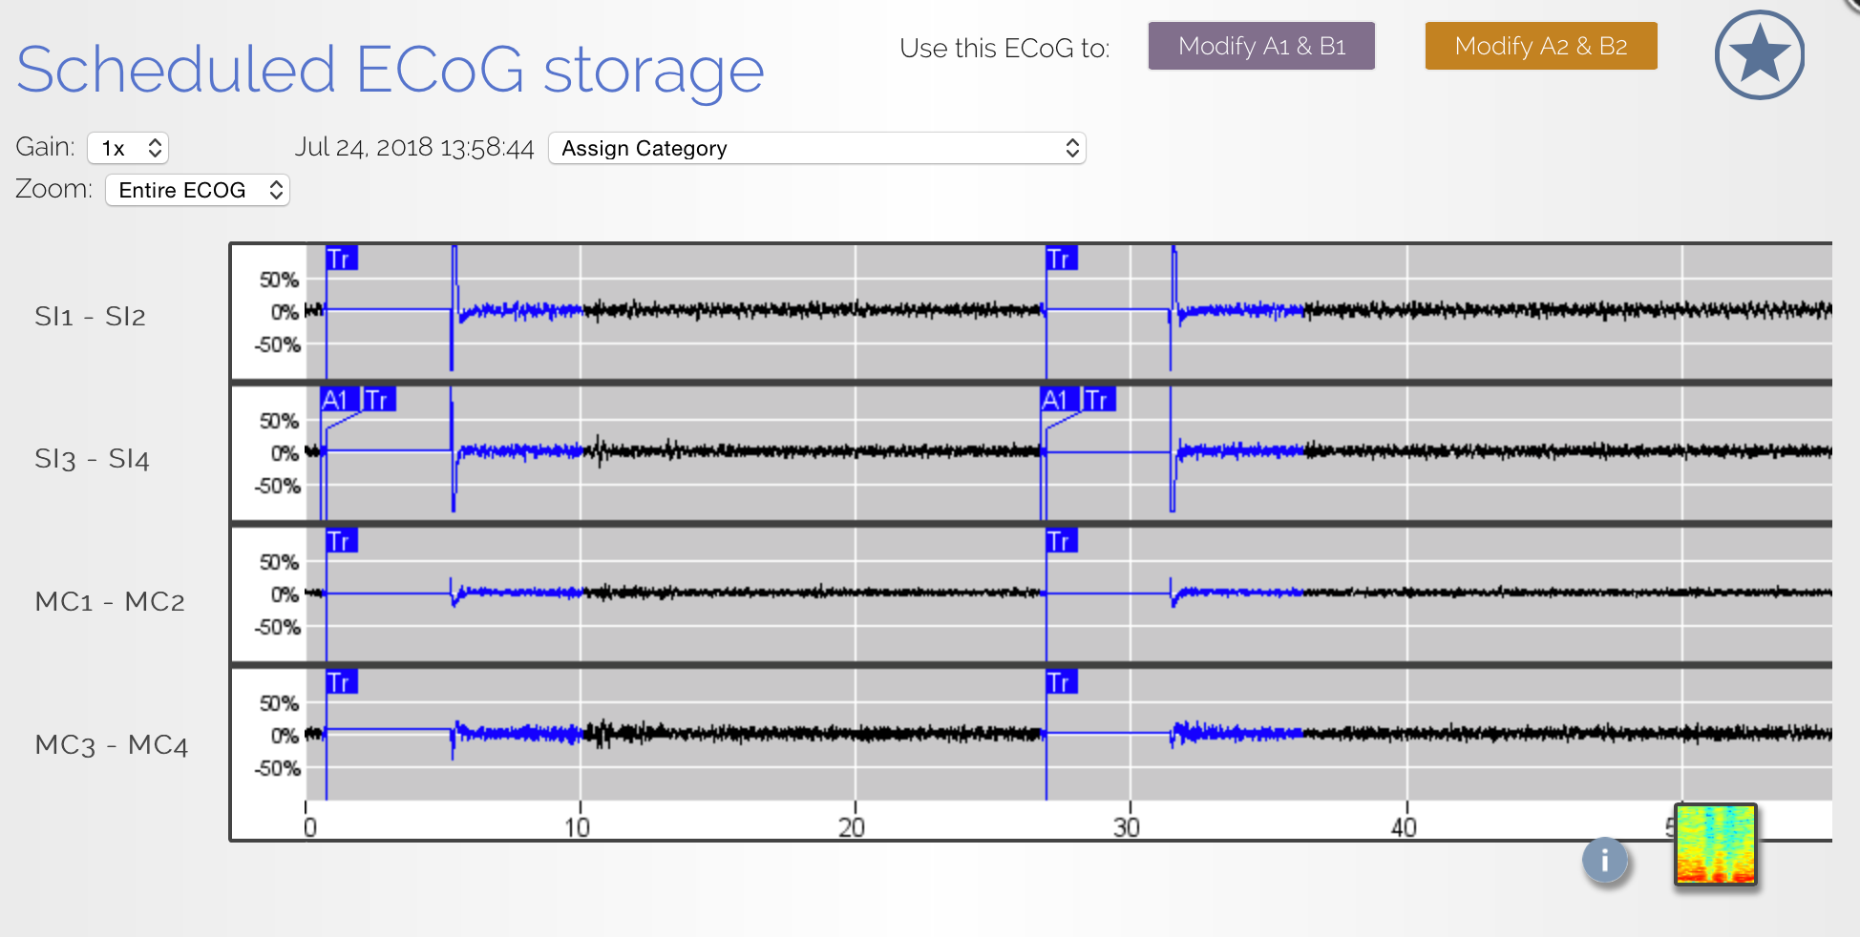
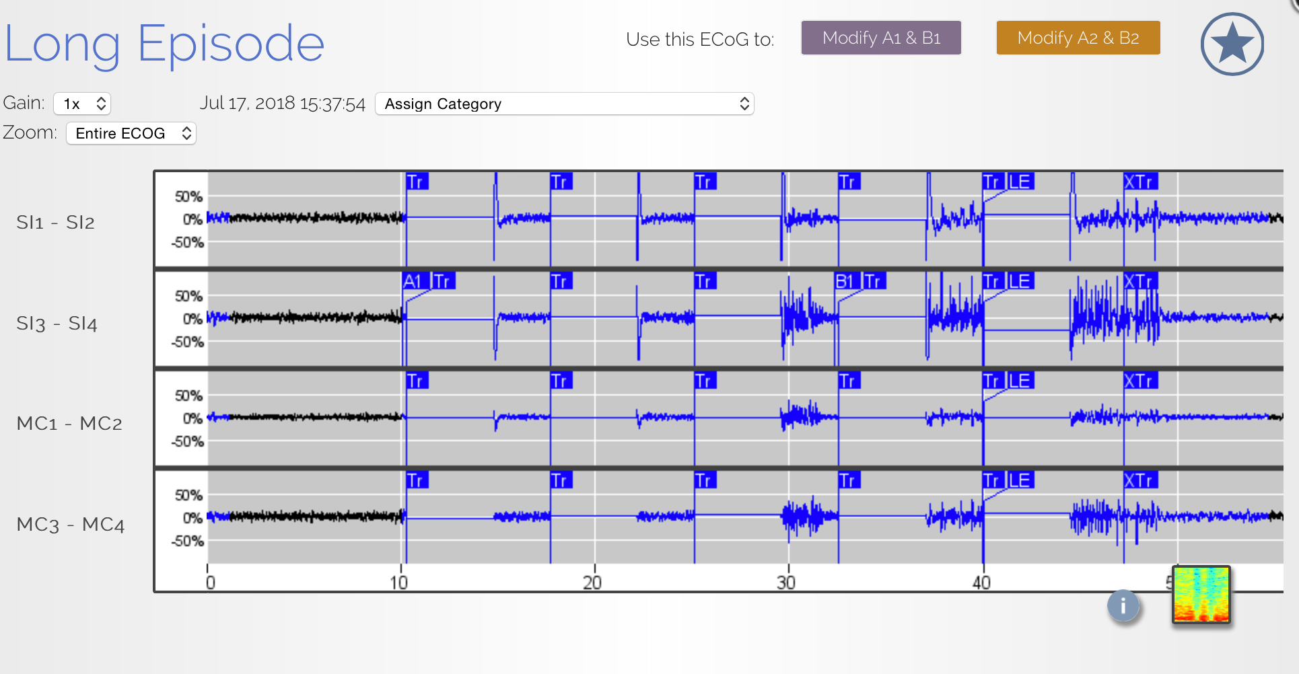
Figure 1 – 4 panels – Background info

Slide 2
Analyzed patients - place at very beginning of results section
Patient ID | Gender | Age | Clean periods (Days) | Leads location
NY231 | F | 33 | 379 | L hippocampal depth R hippocampal depth
NY241 | M | 48 | 294 | R inferior frontal strip R central strip
NY222 | M | 25 | 255, 215 | L insular depth L superior temporal strip
NY229 | M | 26 | 318 | Insular depth L mid-central strip
Notes:
we've identified one long clean period for ...

Slide 3
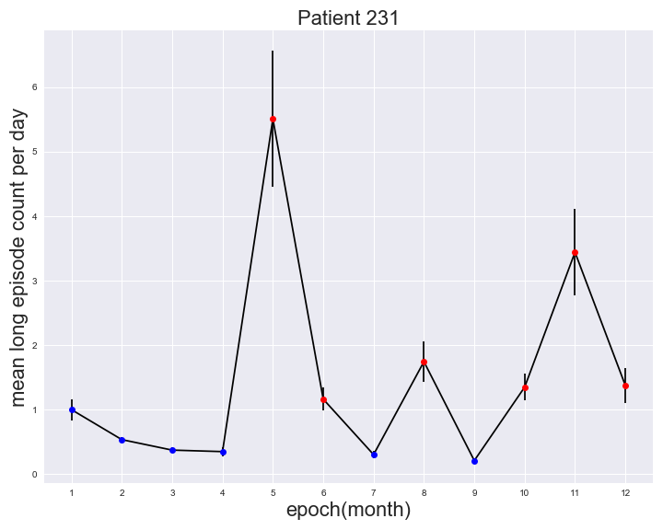
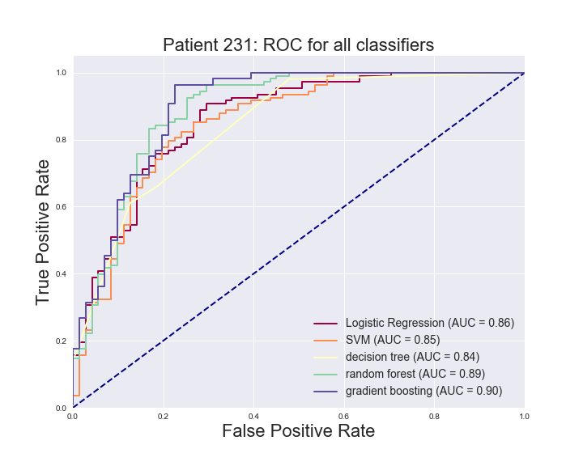
Figure 1 - 5 panels – overall classification performance
Same as above
241
Same as above
241
Summary stats for all patients

Slide 4
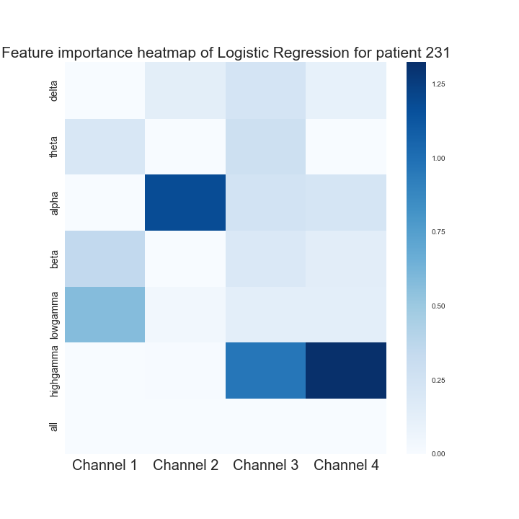
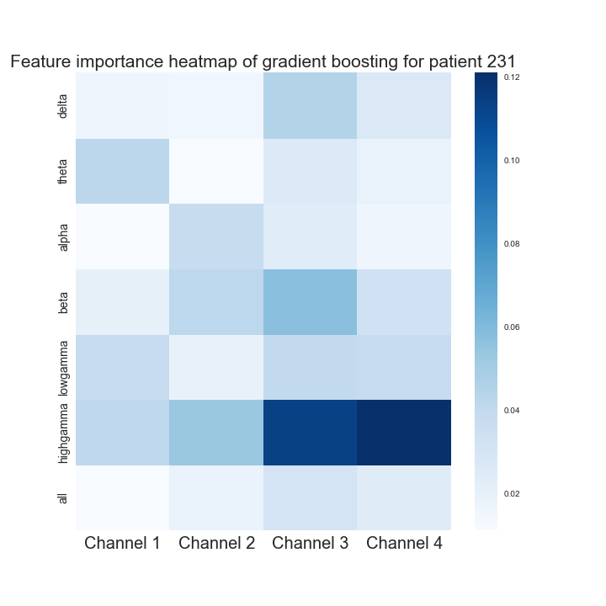
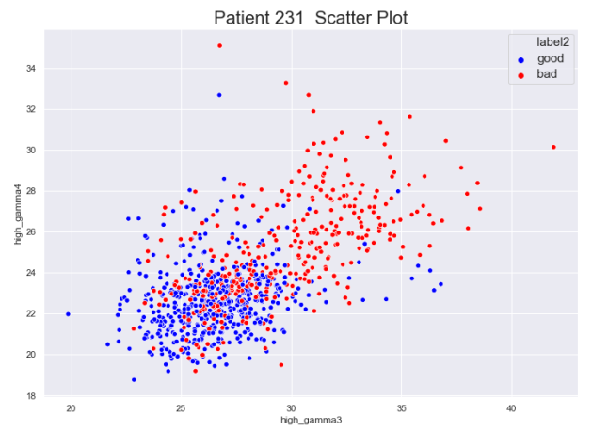
Figure 2 – 7 or 4 panels – Feature importance
Classifier top 1
Classifier top 2
1 or 2 patients
Patient ID | Gender | Age | Clean periods (Days) | Leads location
NY231 | F | 33 | 379 | L hippocampal depth R hippocampal depth
NY241 | M | 48 | 294 | R inferior frontal strip R central strip
NY222 | M | 25 | 255, 215 | L insular depth L superior temporal strip
NY229 | M | 26 | 318 | Insular depth L mid-central strip
Same as above
241
Same as above
241

Slide 5
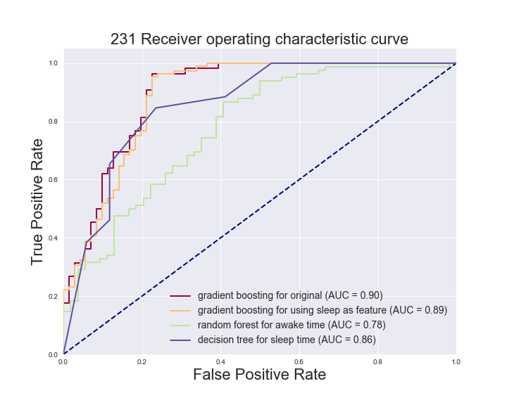
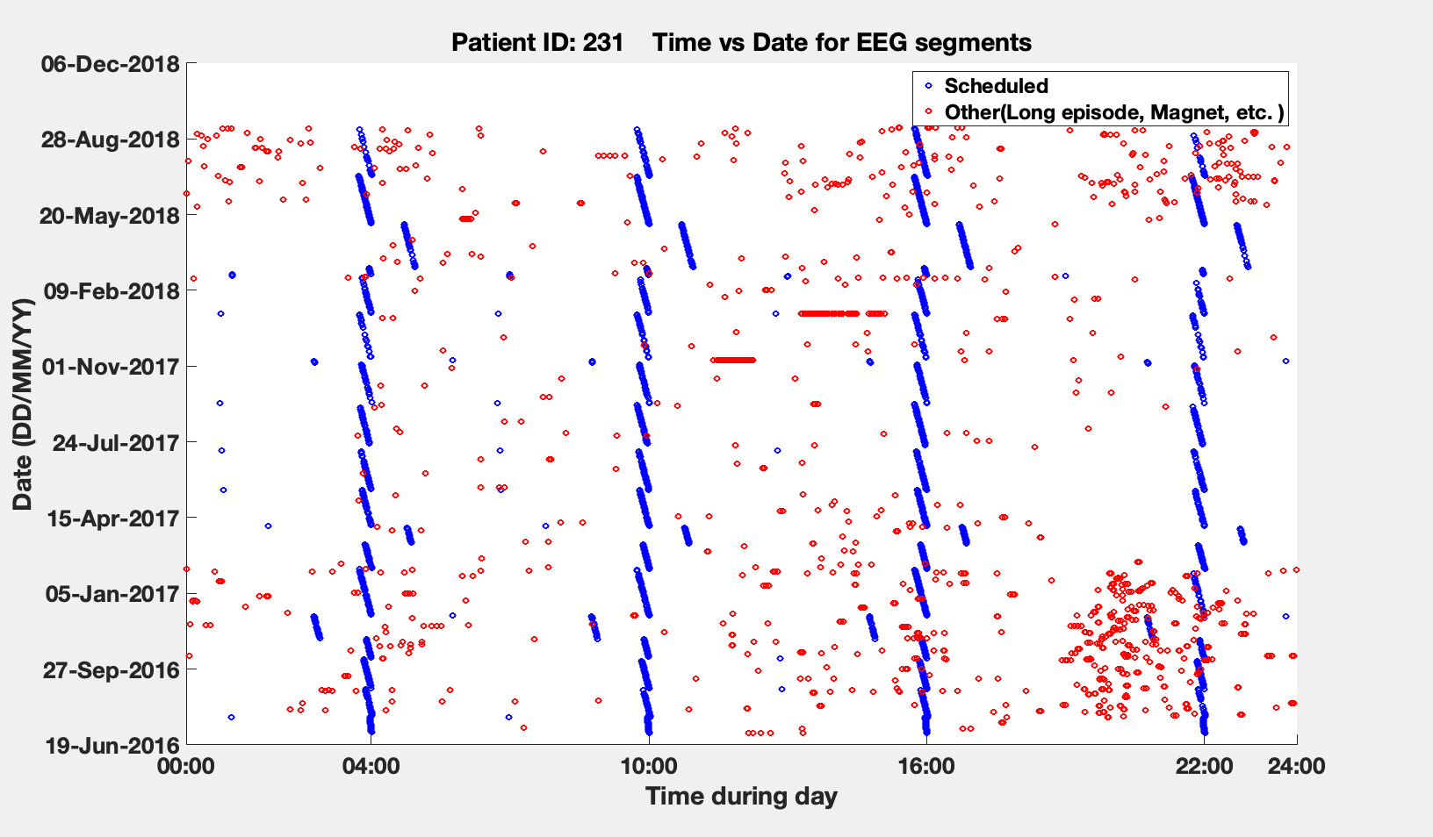
Figure 3 – 4 panels – Sleep
Use two different colors
Random forest for awake-time ECoGs only
Use a different colormap(#2)
Same as above
241
Same as above
241
Day-time VS Night-time

Slide 6
Figure 4 – panels – Small dataset induced classification performance variance
231
Bigger circles for long-episode curve
Different colormap (#3) for the 4 random seeds
Double y-axis labels
Same for 241

Slide 8
(a)
(b)
(c)
(d)

Slide 9
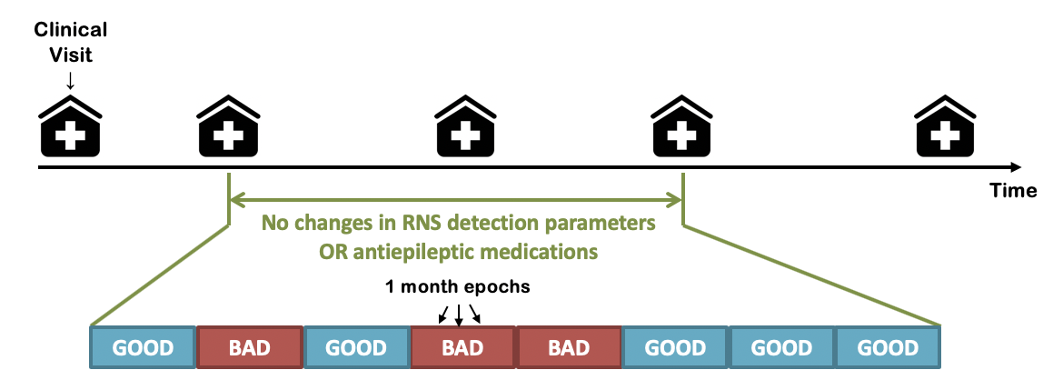
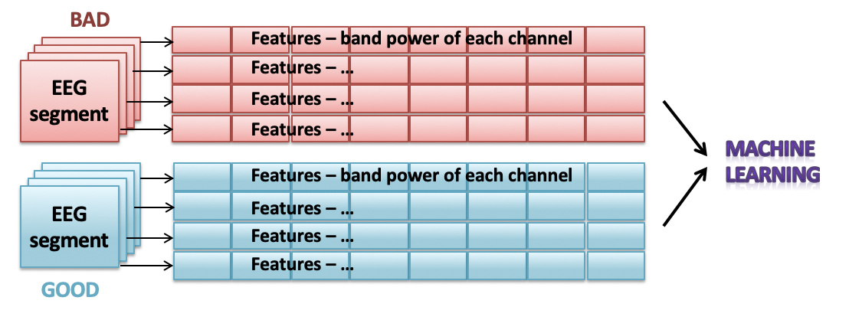
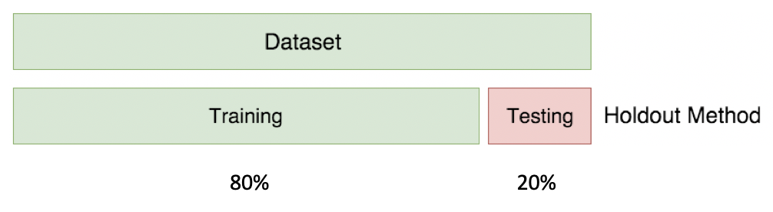
(a)
(b)
(c)

Slide 10
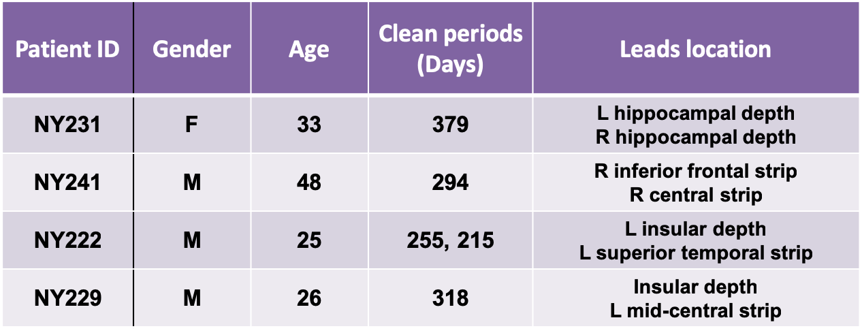
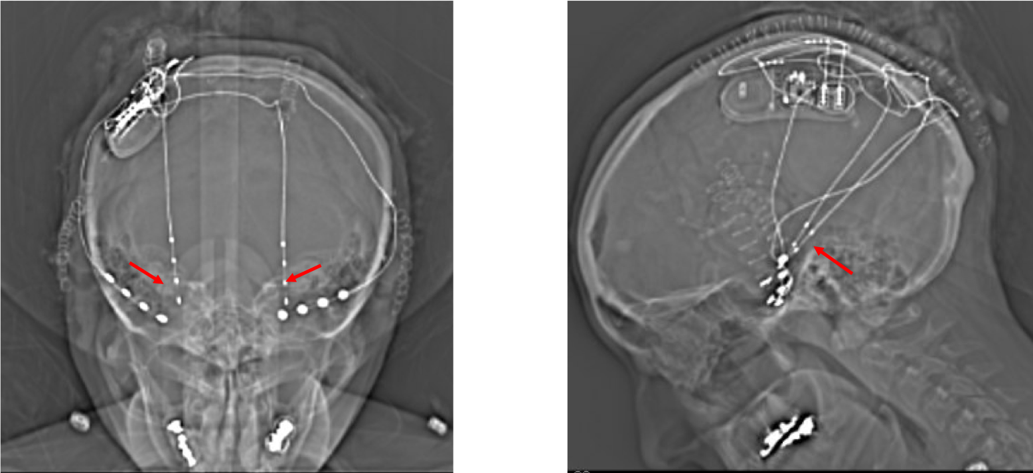
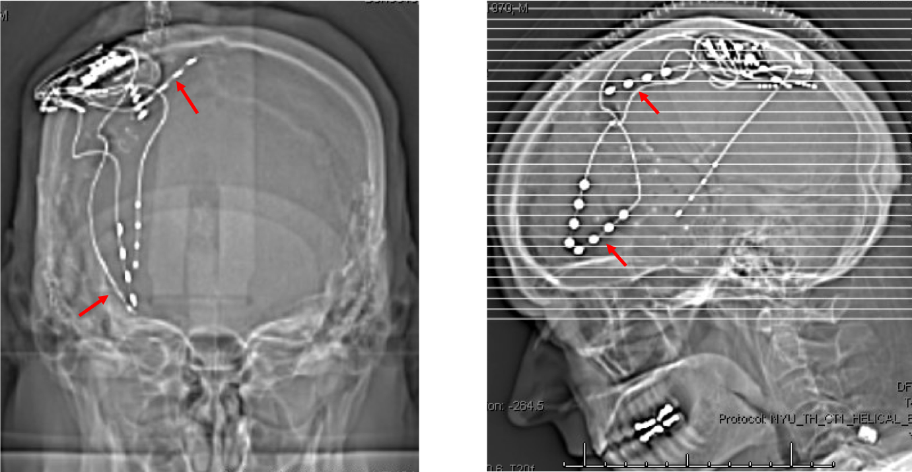
(a)
(b)
NY231
(c)
NY241

Slide 11
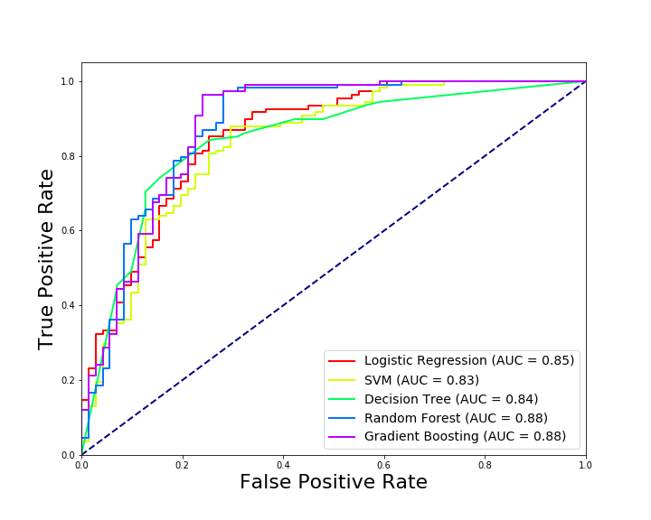
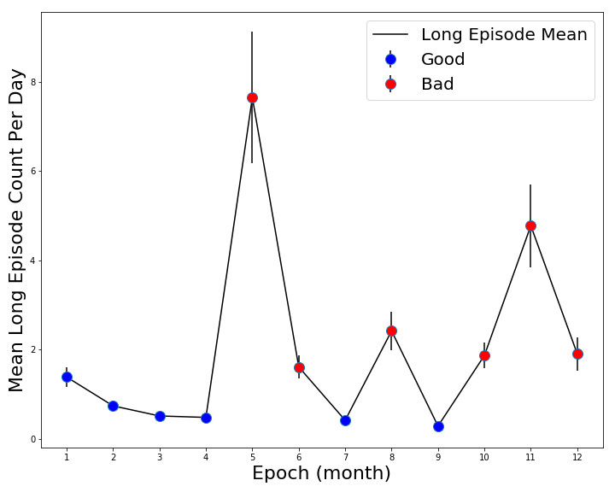
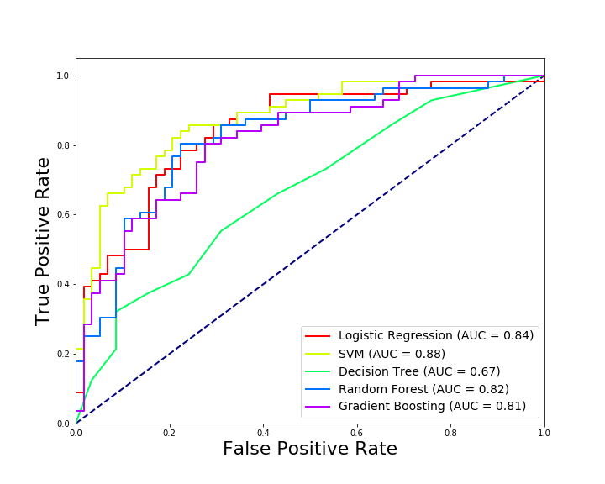
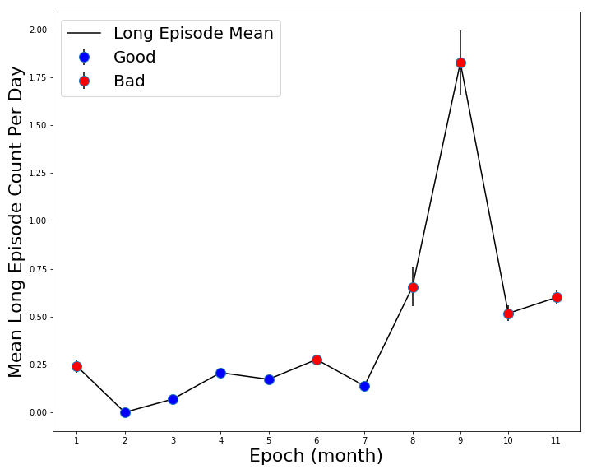
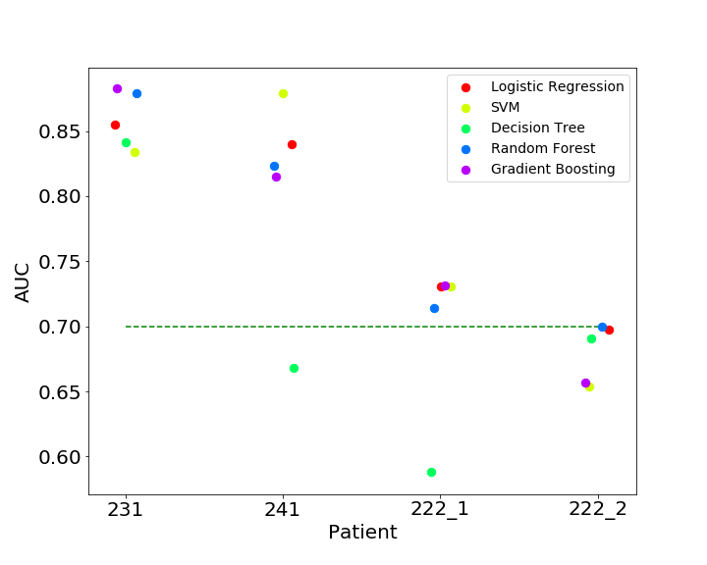
NY231
(a)
(b)
NY241
(c)
(d)
(e)

Slide 12
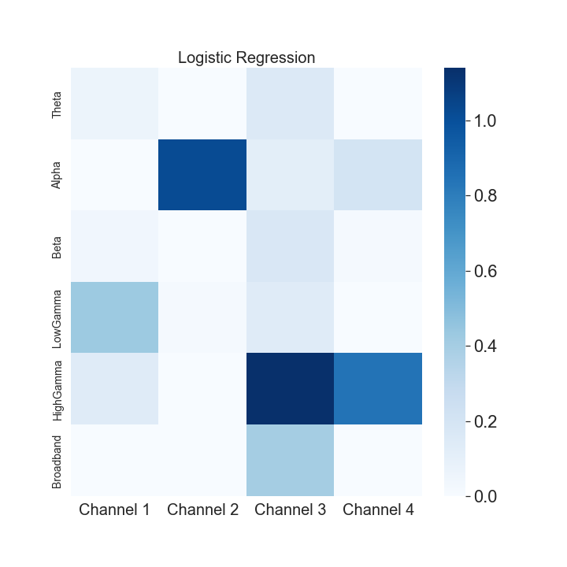
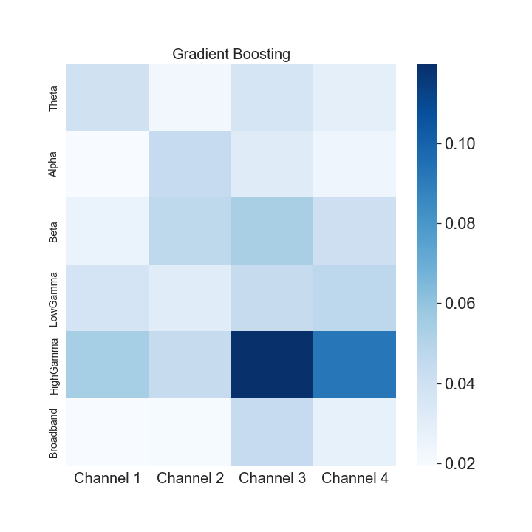
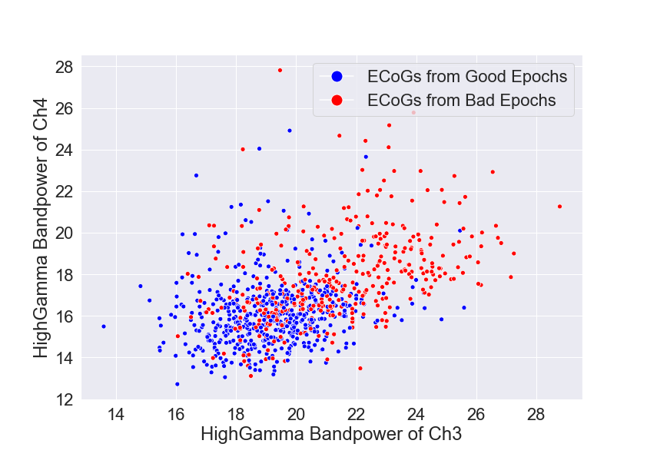
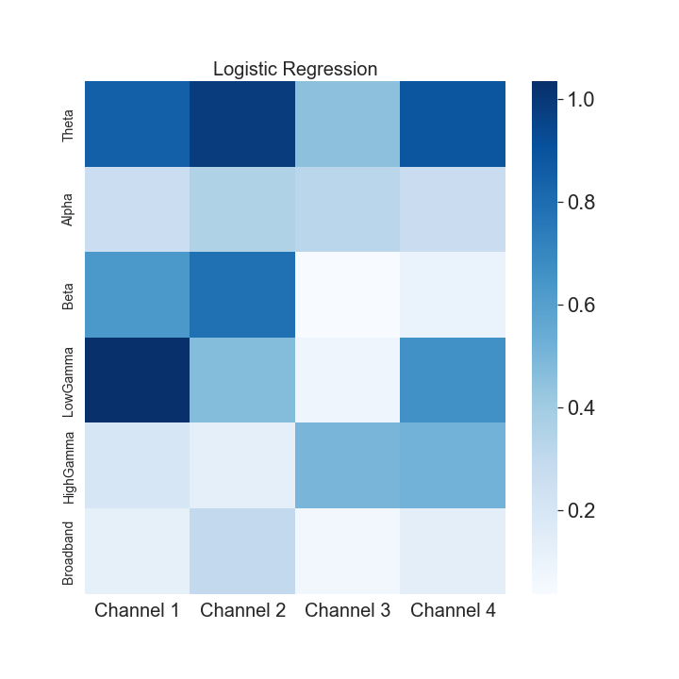
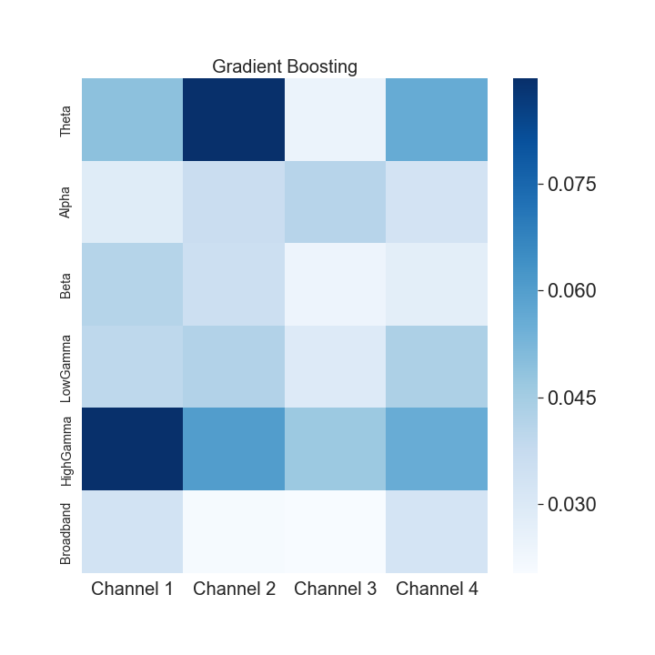
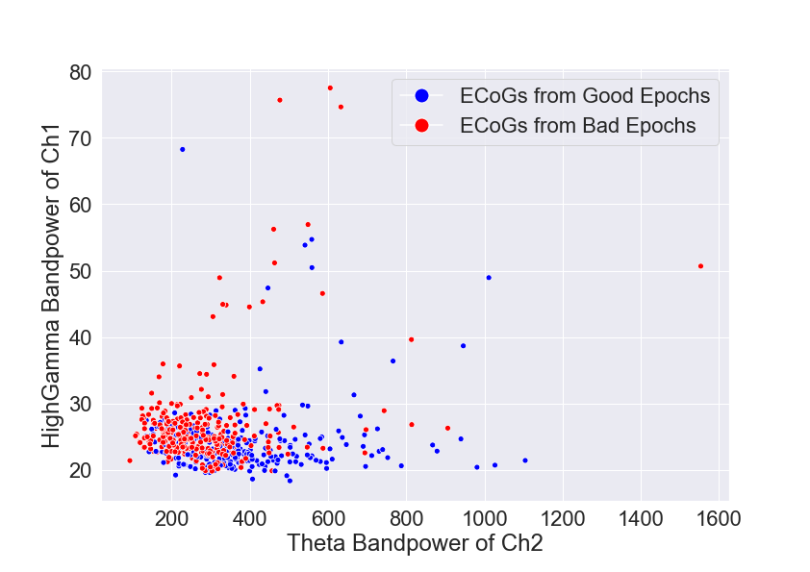
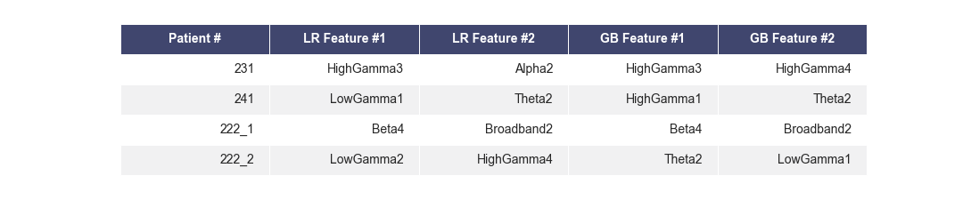
NY231
(a)
(b)
(c)
NY241
(d)
(e)
(f)
(g)

Slide 13
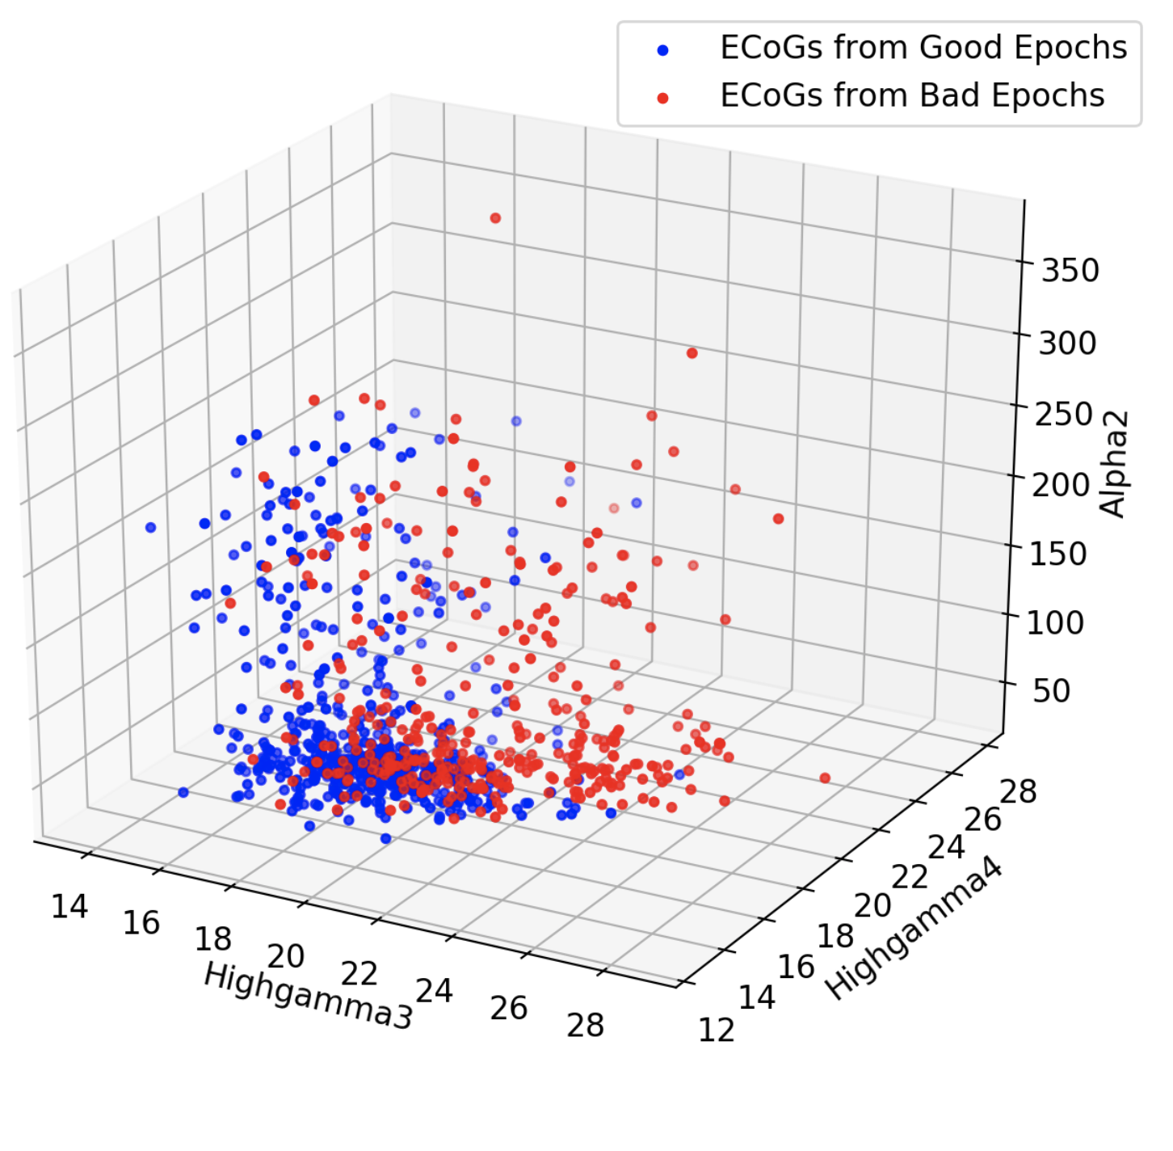
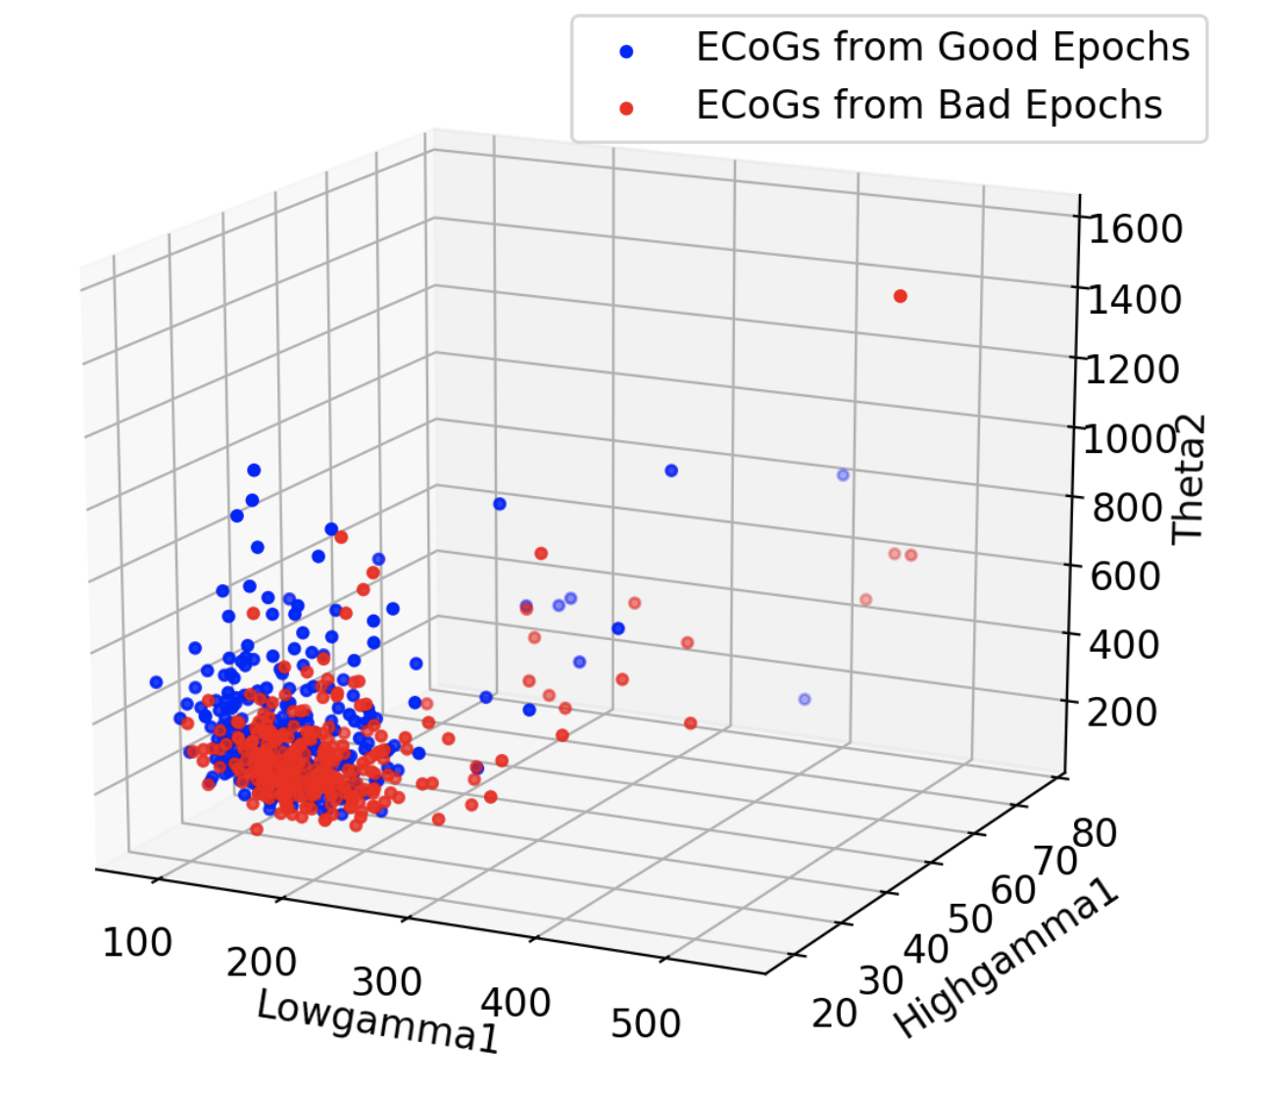
NY231
(a)
(b)
(c)
NY241
(d)
(e)
(f)
(g)

Slide 14
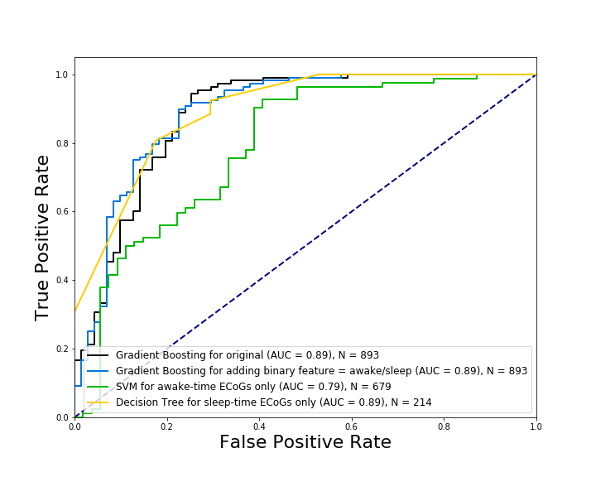
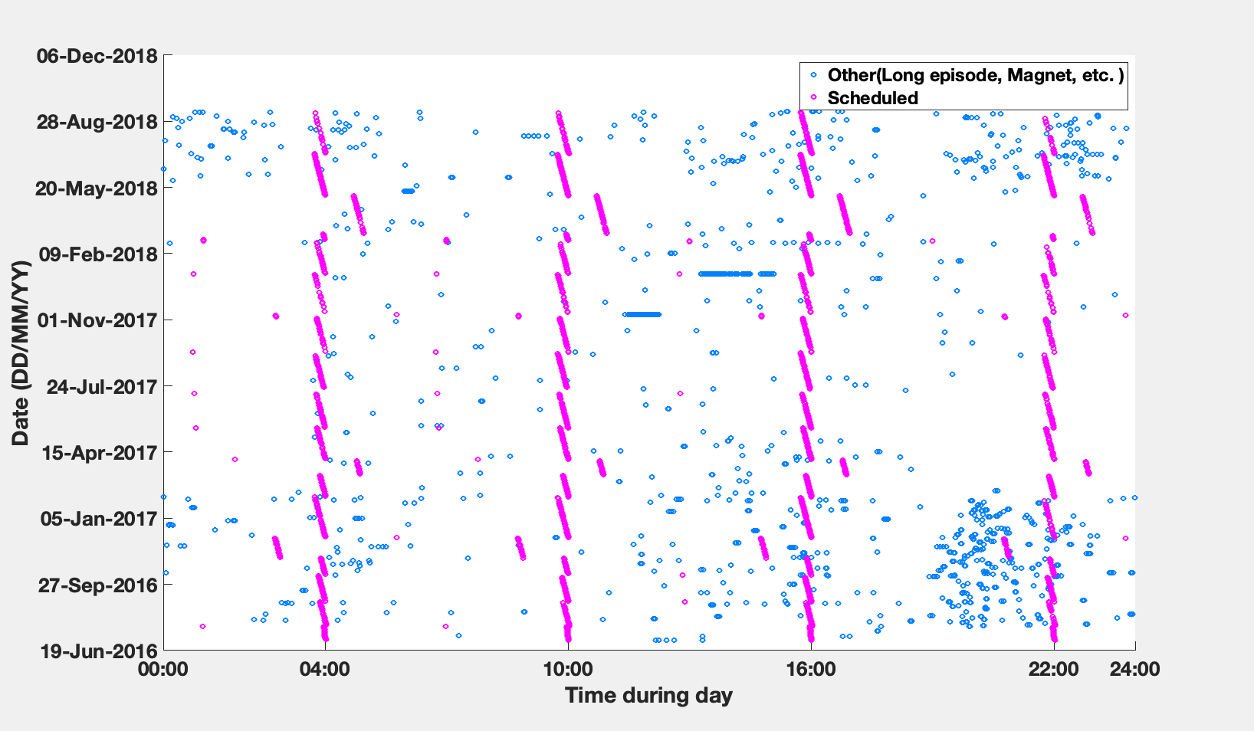
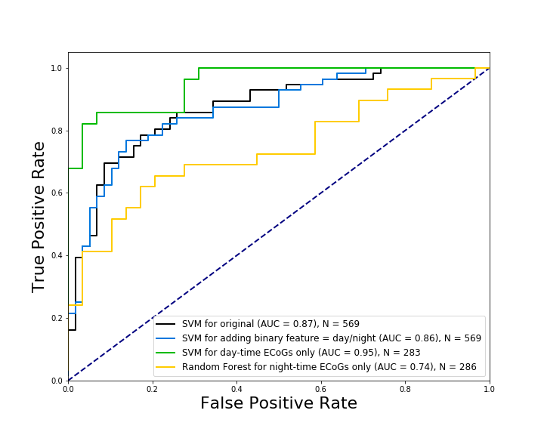
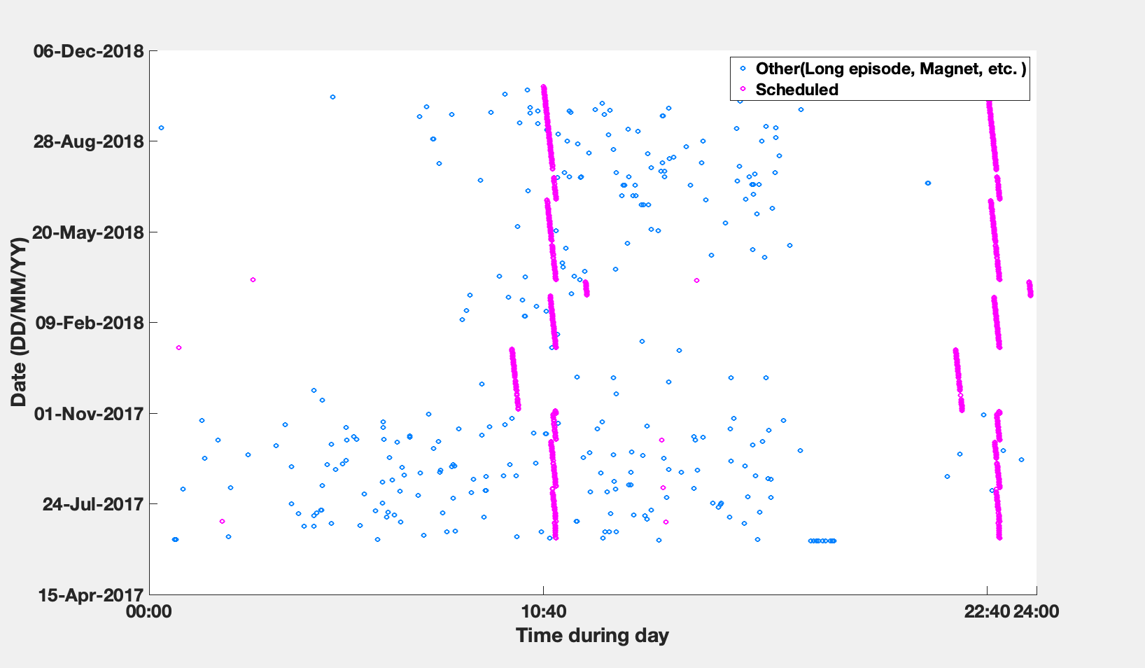
NY231
(a)
(b)
Sleep
Awake
Awake
Sleep
NY241
(c)
(d)
Day
Night

Slide 15
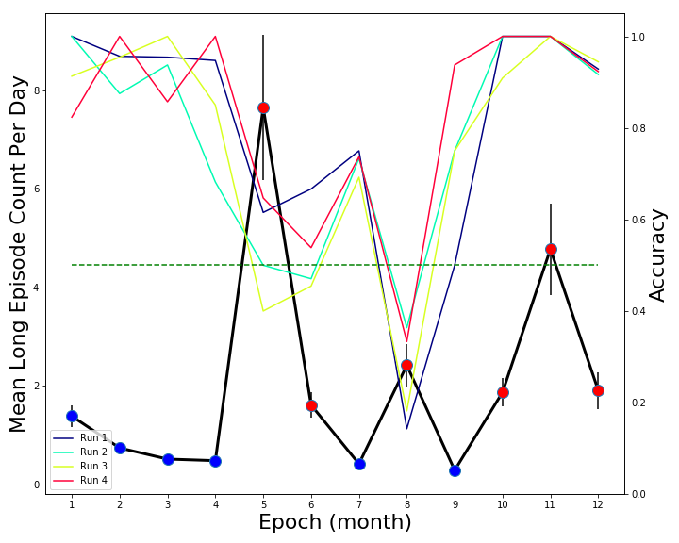
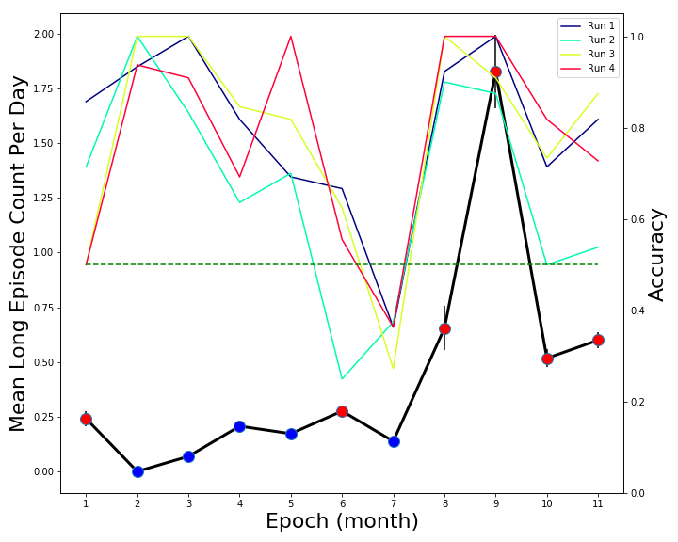
NY231
NY241

